Slide 1
OpenCV CrashCourse
Feb 5th 2017
Notes:
Introduce self
Thank people for being there despite the Super Bowl
Talk about format
Ask how many people have experience with CV and OpenCV

Slide 2
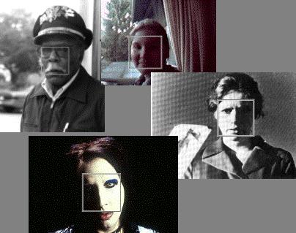
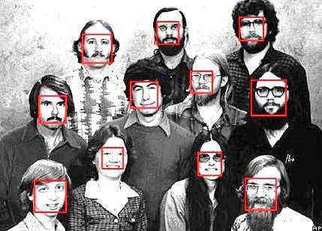
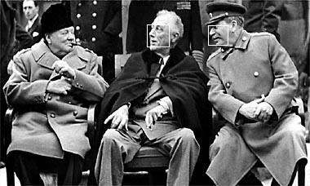
Face detection
Many slides adapted from P. Viola
Notes:
Talk about the task of face detection and why its important from a biological perspective
So we know its a useful thing to solve, lets discuss ways to solve it

Slide 3
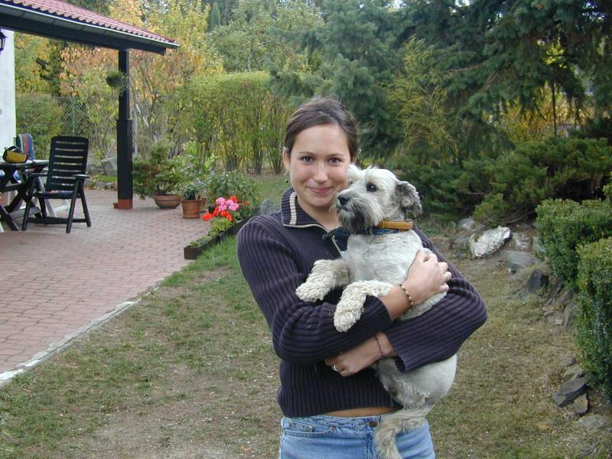
Face detection
Basic idea: slide a window across image and evaluate a face model at every location
Notes:
What we can do is ask if each patch contains a face

Slide 4
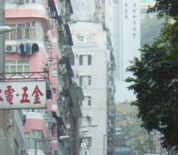

Window-based models Building an object model
Given the representation, train a binary classifier
Face/non-face Classifier
Yes, face.
No, not a face.

Slide 5
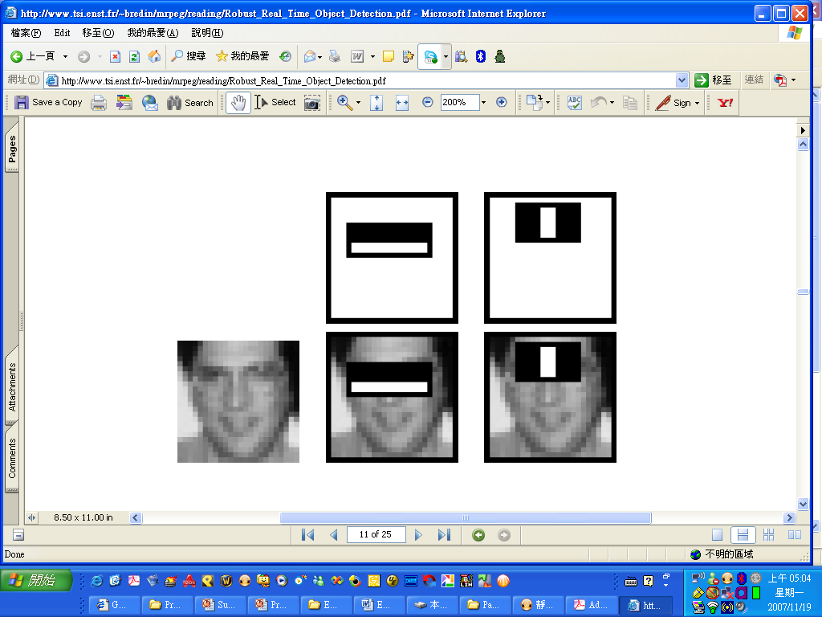
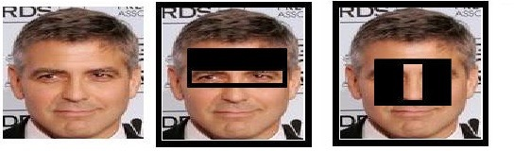
Haar-features (2)
Capture the face symmetry
Notes:
Eyes and forehead have difference in contrast.
Invariant to the person, regardless of skin color etc.
Noise is usually lighter than rest of face, barring illumination issues

Slide 6
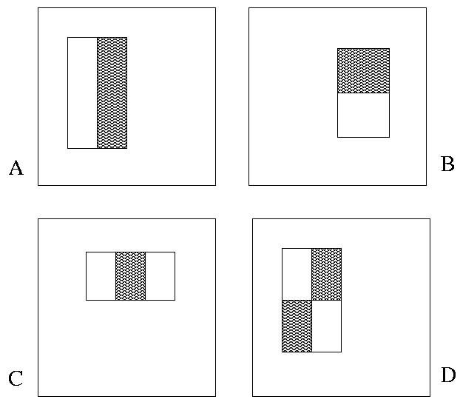
Hear Features
“Rectangle filters”
Value =
∑ (pixels in white area) – ∑ (pixels in black area)
Notes:
For real problems results are only as good as the features used...
This is the main piece of ad-hoc (or domain) knowledge
Rather than the pixels, we have selected a very large set of simple functions
Sensitive to edges and other critcal features of the image
** At multiple scales
Since the final classifier is a perceptron it is important that the features be non-linear… otherwise the final classifier will be a simple perceptron.
We introduce a threshold to yield binary features

Slide 7
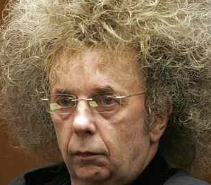
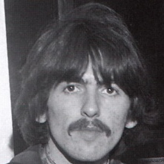
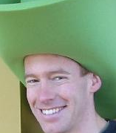
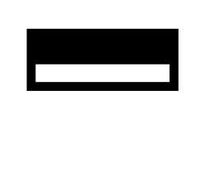

Slide 8
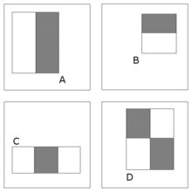
Haar-features (3)
Type A
Four types of haar features
Can be extracted at any location with any scale!
A 24x24 detection window

Slide 9
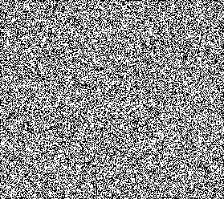

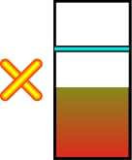

Example
Source
Result

Slide 10
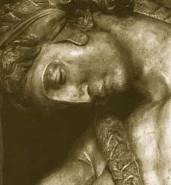
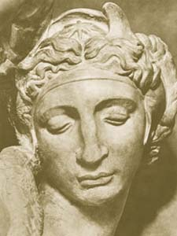
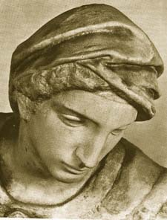
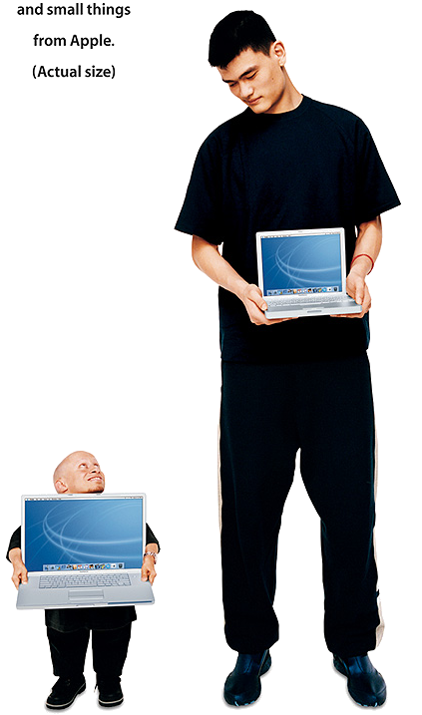
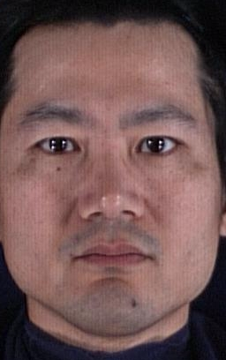
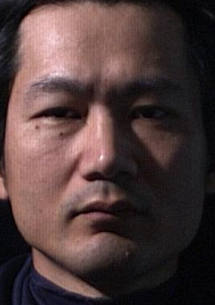
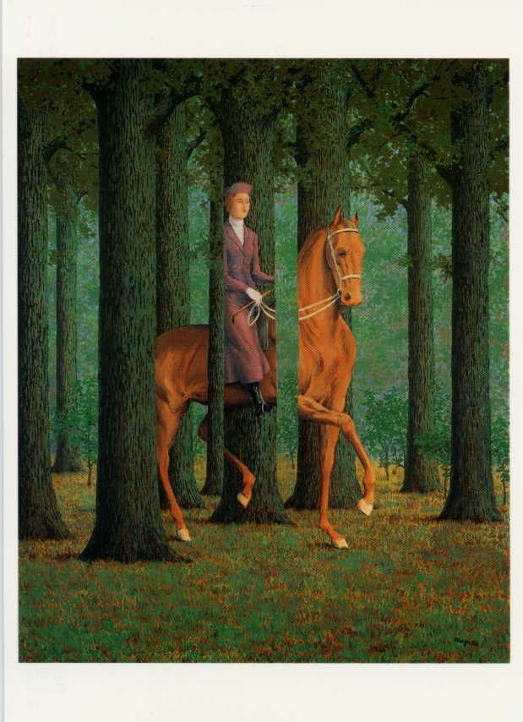
Challenges
view point variation
scale
Michelangelo 1475-1564
illumination
occlusion
Magritte, 1957
Slide credit: Fei-Fei Li

Slide 11
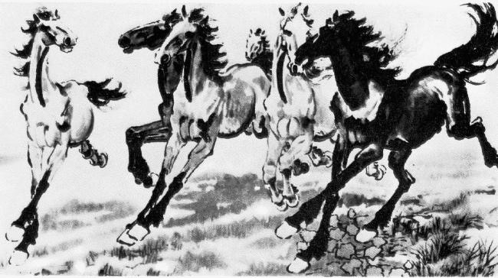
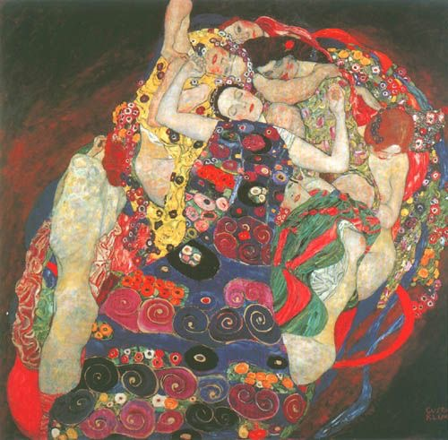
Challenges
deformation
background clutter
Xu, Beihong 1943
Klimt, 1913
Slide credit: Fei-Fei Li

Slide 12
Algorithm
1. Load image
2. Load detector (Haar Cascade)
3. Scan multiple patches of image at different scales to detect which ones are faces
4. Visualize faces by drawing a bounding box

Slide 13
Code
Python 2.7
OpenCV 2.4
Clone repo: https://git.io/vDC81
All code will be pushed to repo after this

Slide 14
3D reconstruction
Idea: Build a 3D representation of an object using images
How many images?
Any specific requirements on the images?

Slide 15
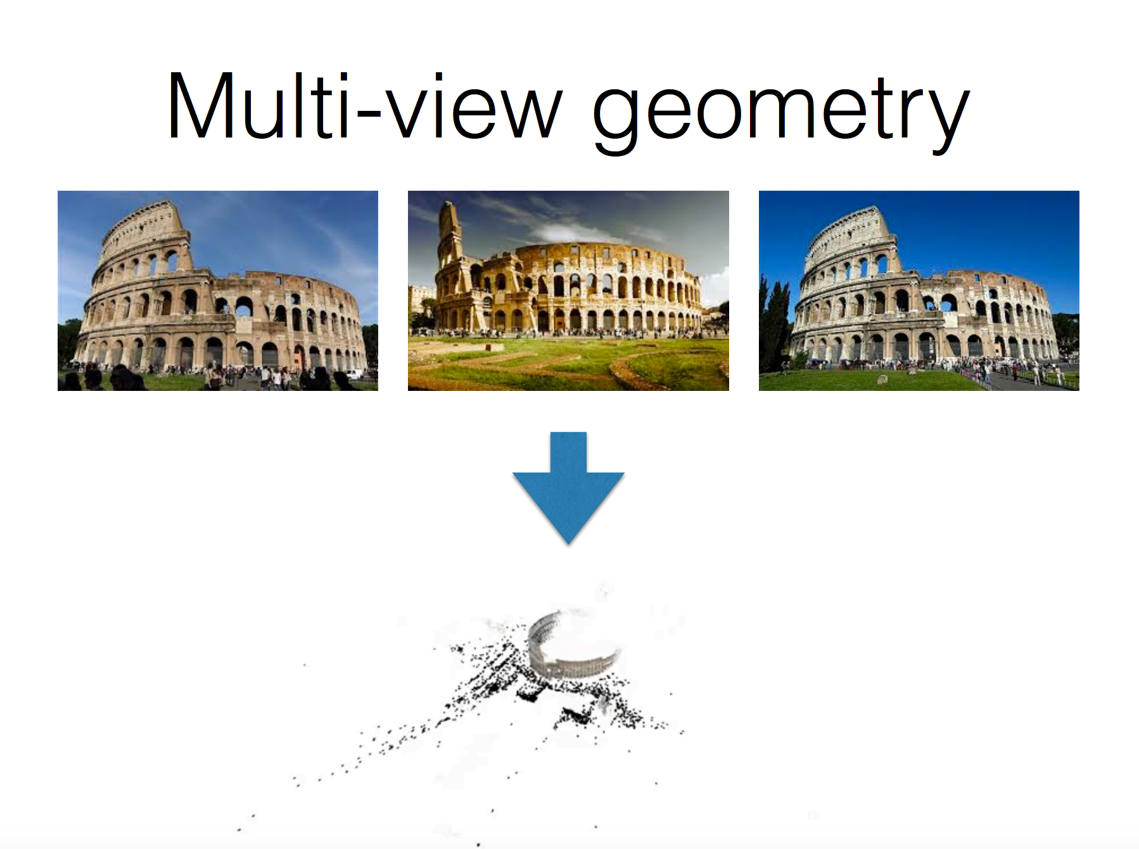

Slide 16
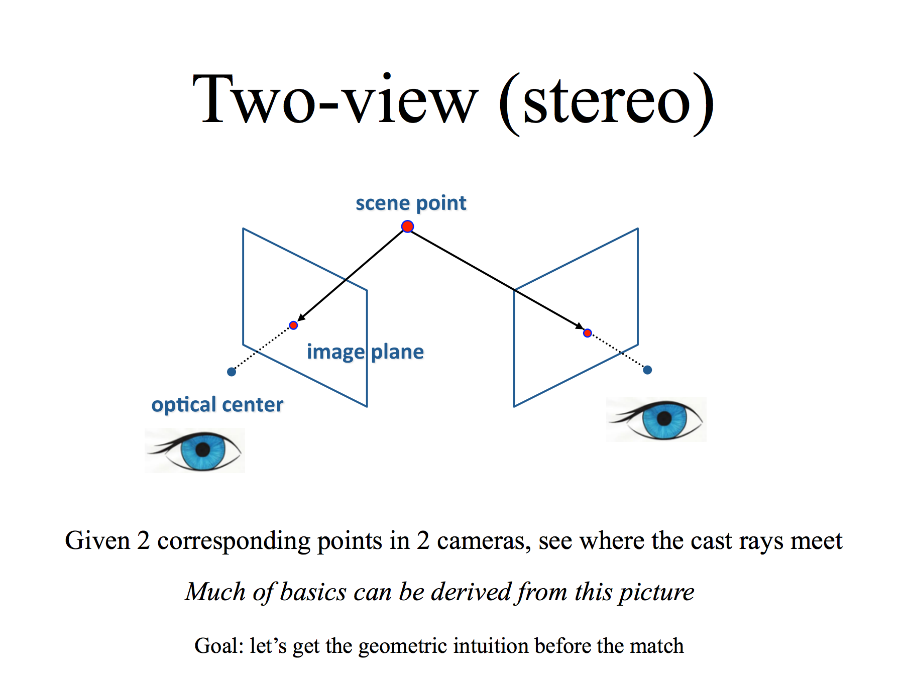

Slide 17
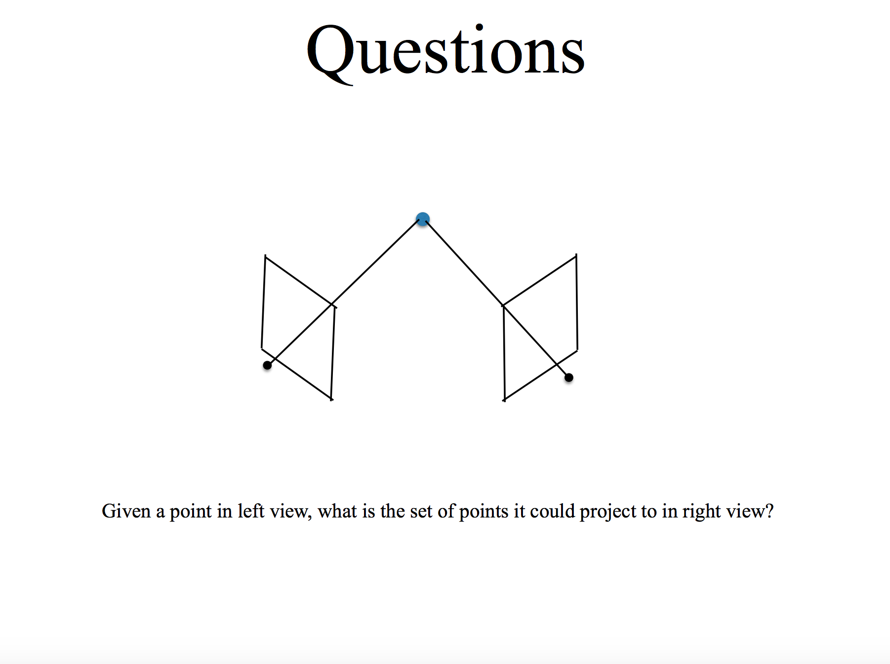

Slide 18
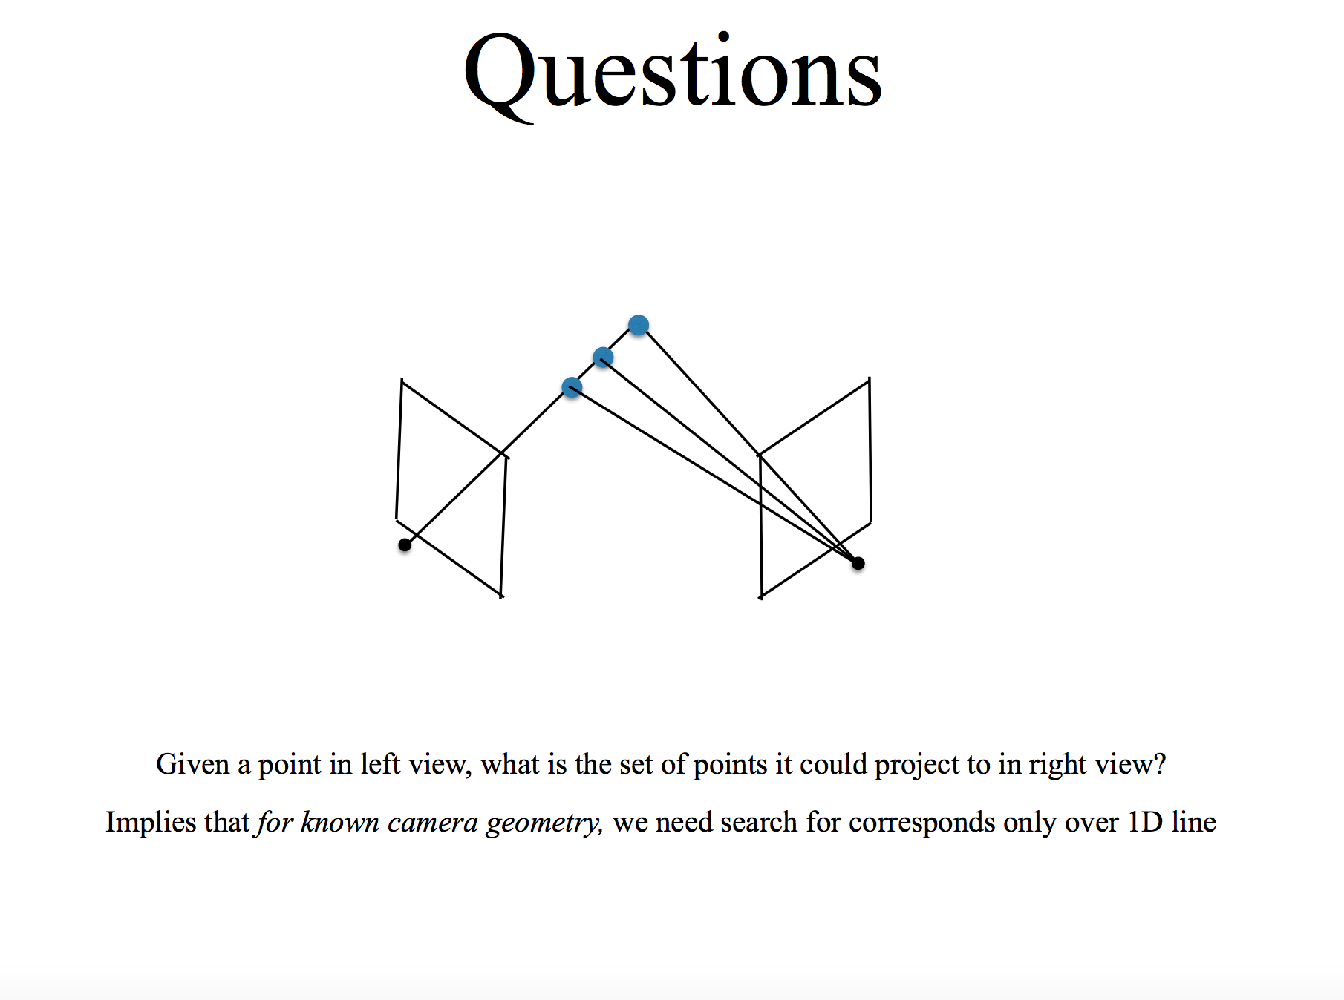

Slide 19
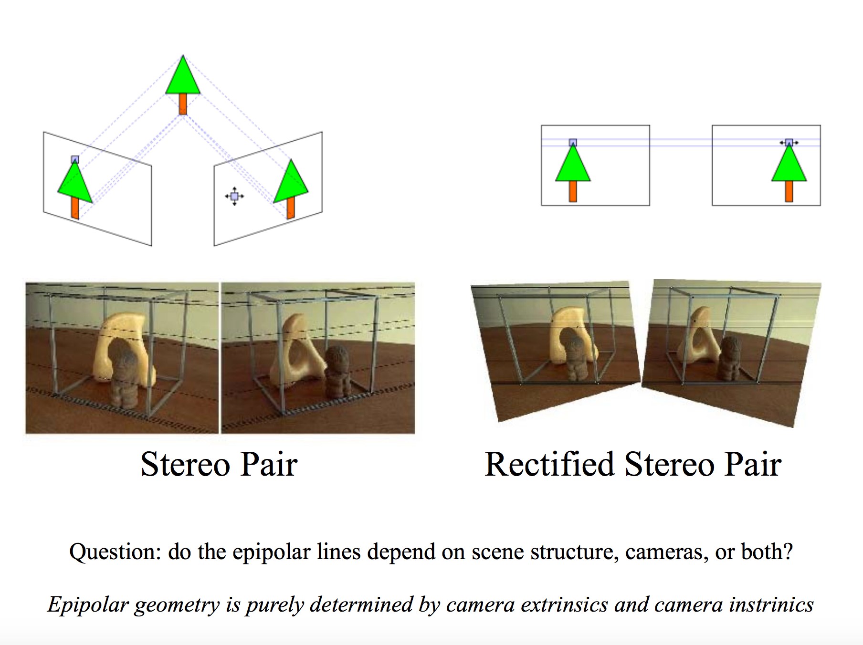

Slide 20
Steps
1. Load left and right images
2. Calculate depth using both images (disparity map)
3. Create 3D point cloud
4. Visualize

Slide 21
Briefly discuss Computer Vision theory
Introduce useful OpenCV functions
Code is up online

Slide 22
3D stereo reconstruction
Theory of stereo vision
Stereo is how our eyes disambiguate depth
Correspondences and shortening search space using Epipolar lines, 2 view geometry, rectification

